Slide 1

Account Aggregator Framework
Transforming India’s Financial Services
OCTOBER 2025

Slide 2

The AA ecosystem is rapidly approaching critical mass
261 crore
financial accounts to
share data via AA
22.3 crore
accounts linked cumulatively
~6.4 crore
estimated financial services delivered (cumulative)
30.8 crore
consents fulfilled cumulatively
~500 crore
Cumulative data packets delivered
Notes:
2009
UIDAI / Aadhaar established – creation of UIDAI to issue Unique Identification Numbers.
Sources: The Times of India, Zoop
2010
AePS (Aadhaar-enabled Payment System) launched – bank-led interoperable financial inclusion at PoS using Aadhaar.
Source: NPCI Milestones
IMPS launched – real-time interbank transfers introduced, enabling 24x7 instant digital payments.
Sources: GeeksforGeeks, NPCI
2014
Pradhan Mantri Jan Dhan Yojana (PMJDY) – initiative to provide universal banking access.
Launch: August 2014 (source verification pending)
2015
Digital India launched – national campaign promoting digital infrastructure, literacy, and digital service delivery.
Launch Date: 1 July 2015
Source: Wikipedia
2016
UPI launched by NPCI – instant, mobile-based bank-to-bank payments.
Launch: April 2016
Source: NPCI
Demonetisation – led to surge in digital payments adoption.
2016–2017
Jio launched – affordable 4G internet plans, driving mass adoption of digital payments, UPI, and online services.
Source: Reliance Jio history
2017
BharatQR launched – standardized QR codes for merchant payments, promoting interoperability.
Source: NPCI Milestones
GSTN launched – digital platform for GST compliance, invoicing, and return filing.
Source: GSTN official website
2020
COVID-19 Pandemic – accelerated digital adoption among citizens and MSMEs.
Sources: Taylor & Francis Online, Center for Financial Inclusion
2021
Formal launch of Account Aggregator (AA) ecosystem – secure, consent-based financial data sharing framework.
Launch: 2 September 2021
Sources: The Economic Times, Business Standard
2024
UPI Lite & UPI 123Pay expanded access – enabling feature phone users and low-internet users to transact via IVR, missed call, etc.
Sources: NPCI product overview, Angel One

Slide 3
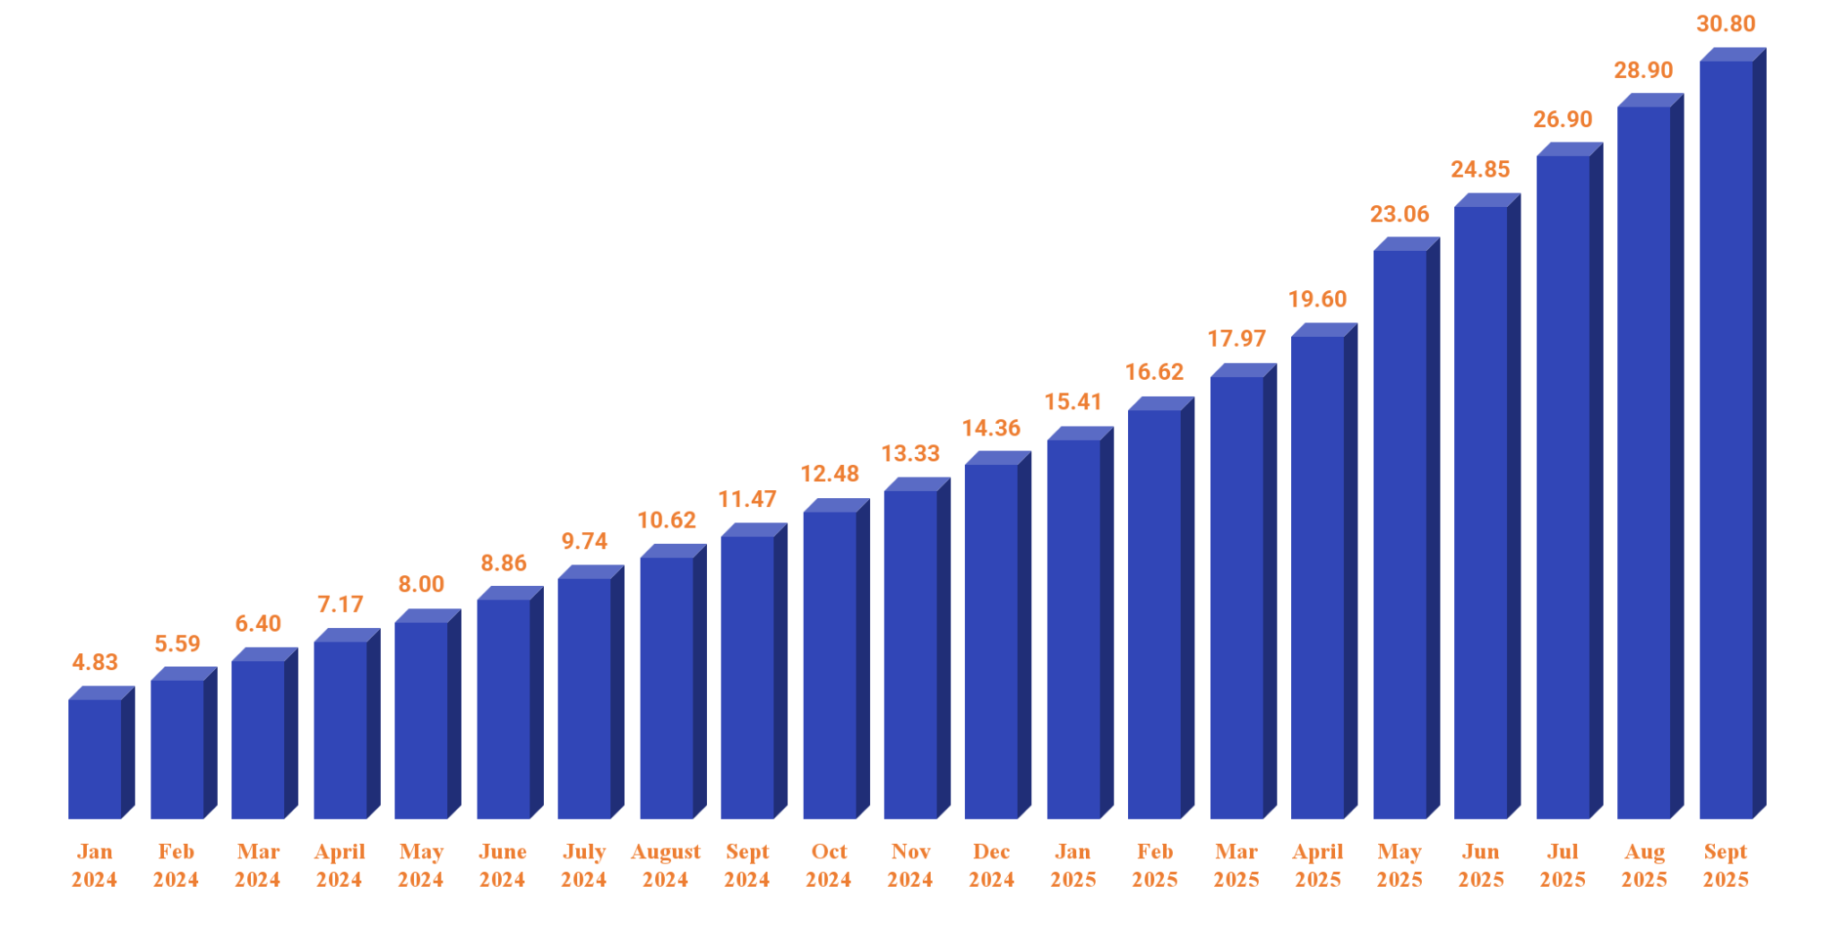
Rapid scale-up of the AA ecosystem in the last 18 months
Graph – Cumulative consents fulfilled (in crores)
The sharp increase in May '25 figures is due to the inclusion of data from a leading AA, which had not been reported in earlier months.
Notes:
When did PSU banks onboarded??

Slide 4


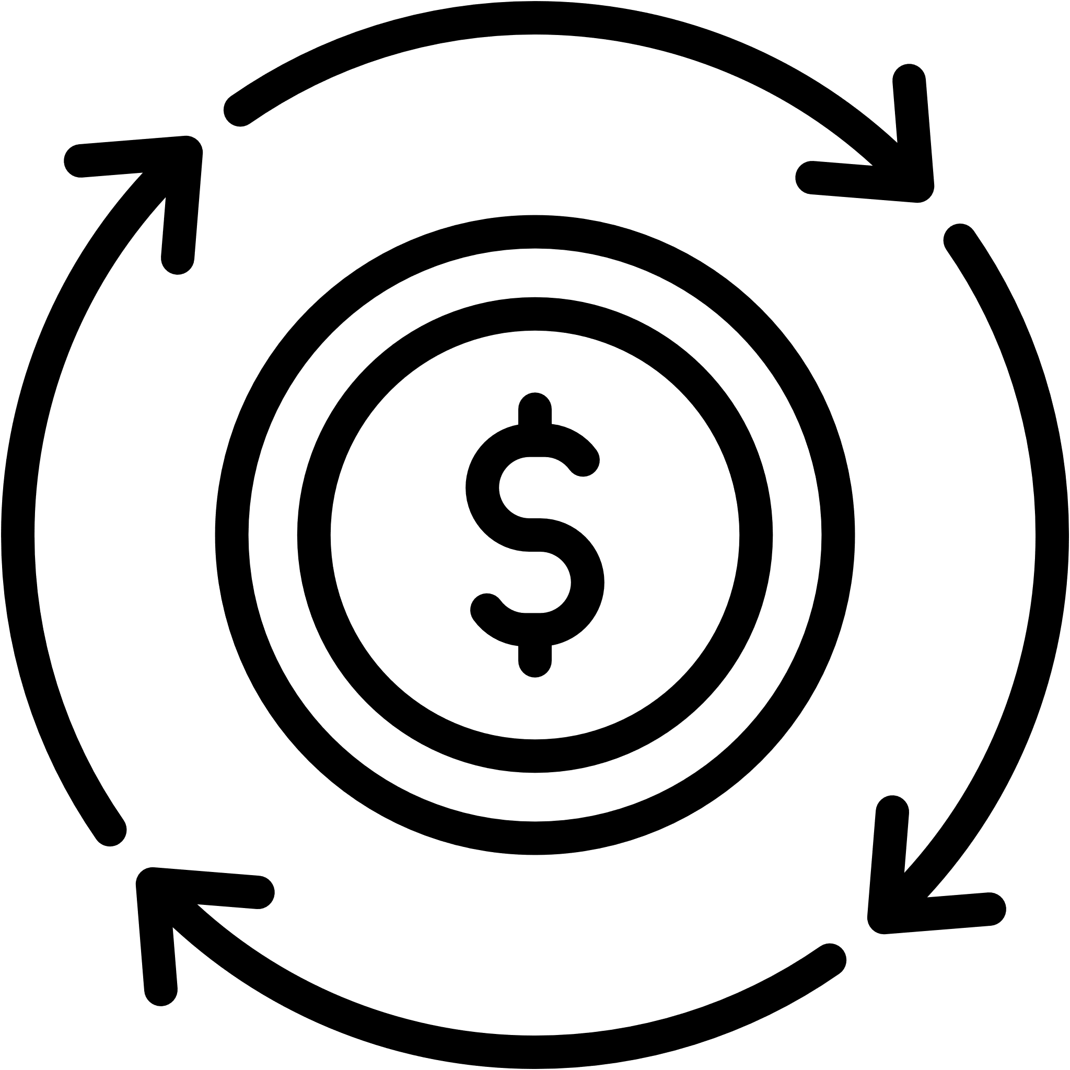



















AA has enabled impactful use cases across sectors-30th Sept ’25
Majority of the large financial institutions are using the consent based framework!!
14 Use Cases/Purposes
Bank account verification
12/12 Public Sector Banks
14/21 Private Sector Banks, 1/45 Foreign Bank
Loan underwriting
Vendor risk profiling
24/24 Life and 19/27 Non Life and 5/6 Health insurance
12/138 corp agent/marketing/broker
Opening of Demat Accounts
35/43 RRBs, 2/352 DCCB,
2(NABARD and SIDBI)
Monitoring for repayment & early warnings
Monitoring accounts for collections
776*
Financial Institutions live as FIUs
Balance check before debit/eNACH
Monitoring recovery agents and employees
Wealth management and advisory
389/9438
NBFCs/HFCs AD-II/MFIs/PPI
5/10 Small Finance Banks
2/3 TReDS
Personal finance management
Income verification for F&O account opening
Financial underwriting for life insurance
Employee trading activity monitoring
254/9120 SEBI regulated entities
0/53 PFRDA regulated entities
Monitor the efficacy of welfare schemes
*Includes 650 financial institutions which are only FIU and 126 Financial Institutions which are both FIP and FIU

Slide 5
261 crore accounts enabled – approx. 64% of total accounts in the sector
S No | Account types | Number of accounts enabled | Number of accounts (Estimated total) | Coverage (~%)
1. | SCBs + RRBs | 1721 M | 2693 M | 64%
3. | NBFC Deposits | 10 M | - | N.A.
4. | Life Insurance | 52 M | 330 M | 16%
5. | General Insurance | 313 M | 348 M | 96%
6. | DeMat Accounts | 193 M | 193 M | 100%
7. | GSTN | 15 M | 15 M | 100%
8. | Mutual Fund | 248 M | 248 M | 91%
9. | Pension Fund | 63 M | 63 M | 100%
10. | Co-operative Banks | 5 M | 225 M | 2%
TOTAL |  | 2613 M | 4114 M | 64%
Currently, we are working on stabilizing the following providers & data types:
Banks – term deposits (FD/RD)
Invite remaining private banks
GSTN – enhancing performance
Additionally, we have submitted proposals to relevant stakeholders to activate:
Additional returns from GSTN
EPFO passbook from EPFO
ITR data from CBDT
Joint and corporate accounts
Small savings schemes

Slide 6

AA is enabled with cross sectoral data types-30th Sept ’25
60% of financial accounts are now available to be shared using the consent based framework!!
16 FI Types: Already Live
12/12 Public Sector Banks
14/21 Private Sector Banks, 3/45 Foreign Bank ,1(SIDBI),
Deposits (Singly held savings a/cs & sole-prop current a/cs)
Term Deposits
Recurring Deposits
23/24 Life and 20/27 Non Life and 6/6 Health insurance
43/43 RRBs, 5/10 SFBs, 3/26 NBFC-D , 1/7 HFC,
2/1500 UCBs
Equity Shares (Demat)
Exchange Traded Funds
Mutual Funds Units (Physical)
180*
Financial Institutions live as FIPs
Insurance Policies
Unit Linked Investment Plan
Balances under National Pension System
Goods and Services Tax Return (GSTR 1 & 3B)
1/1 GSTN
41/45 AMCs
Systematic Investment Plan (Demat & Non Demat)
AIFs (Demat)
3/3 Pension CRAs
2/2 Depositories
IDRs
CIS
InVIT
*Includes 54 financial institutions which are only FIP and 126 Financial Institutions which are both FIP and FIU

Slide 7
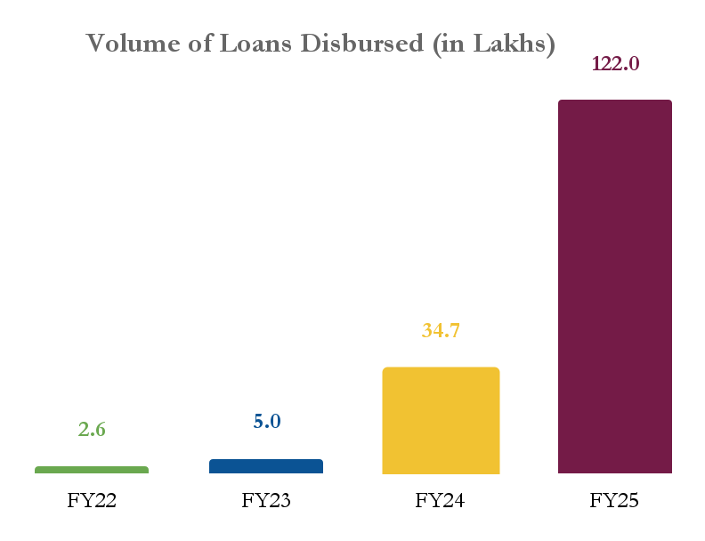
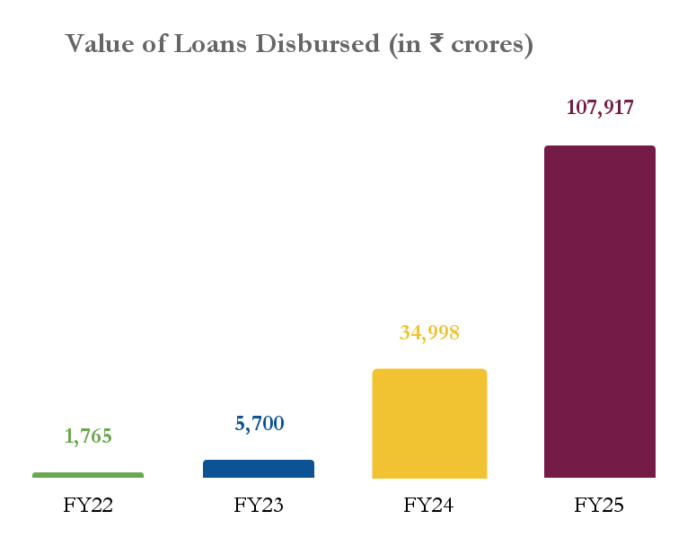
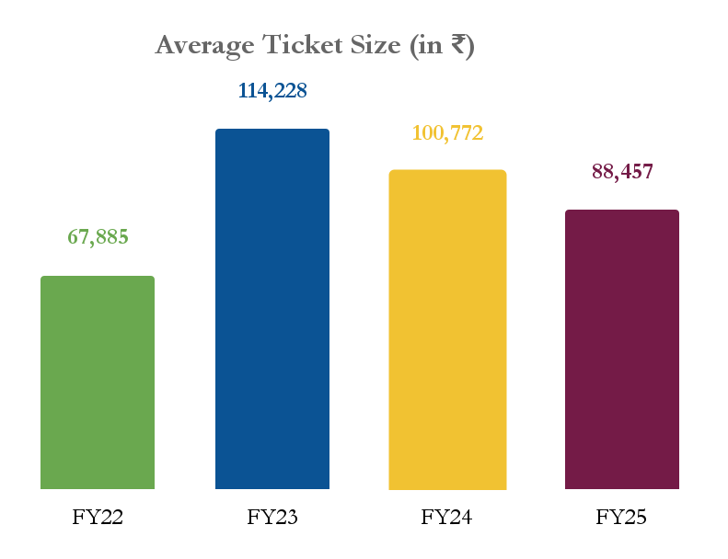
AA-facilitated lending – Rising volume & value, and declining ticket sizes
AA-enabled lending has witnessed exponential growth in both volume and value over the last three years.
This growth has been driven primarily by NBFCs, with several institutions reporting that AA now enables 50–80% of their total disbursements.
Banks are now actively integrating AA into their credit journeys and are poised to scale up rapidly.
NOTE: All the numbers in the graphs above are based on the actual, self-reported statistics by leading lending FIUs in the Account Aggregator (AA) ecosystem.

Slide 8
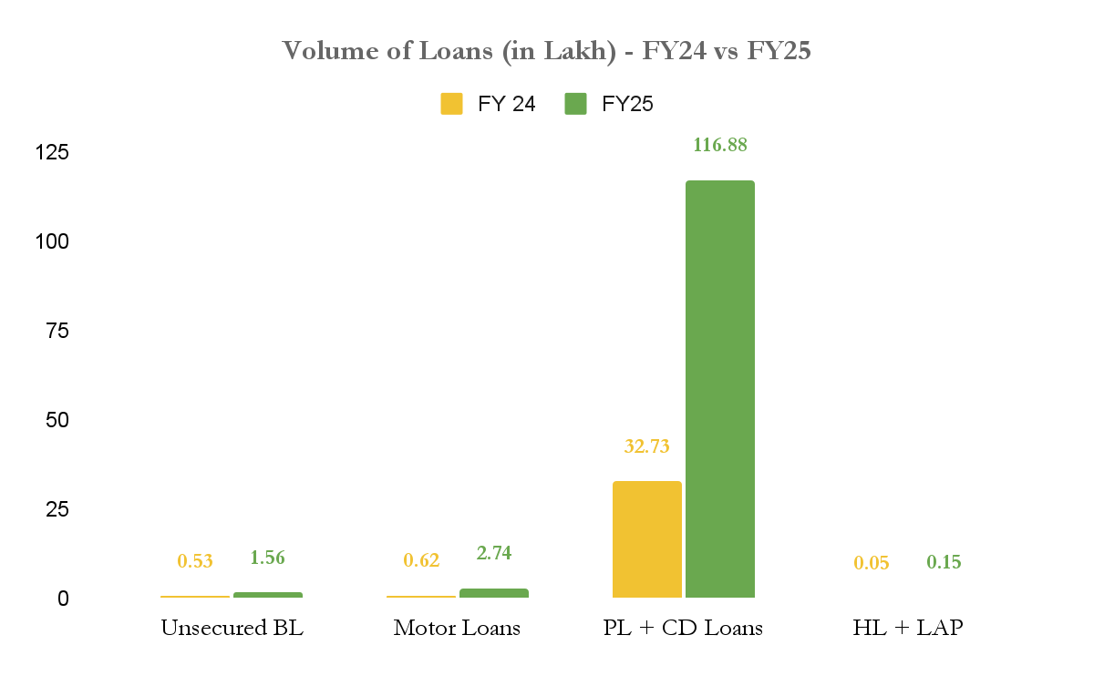
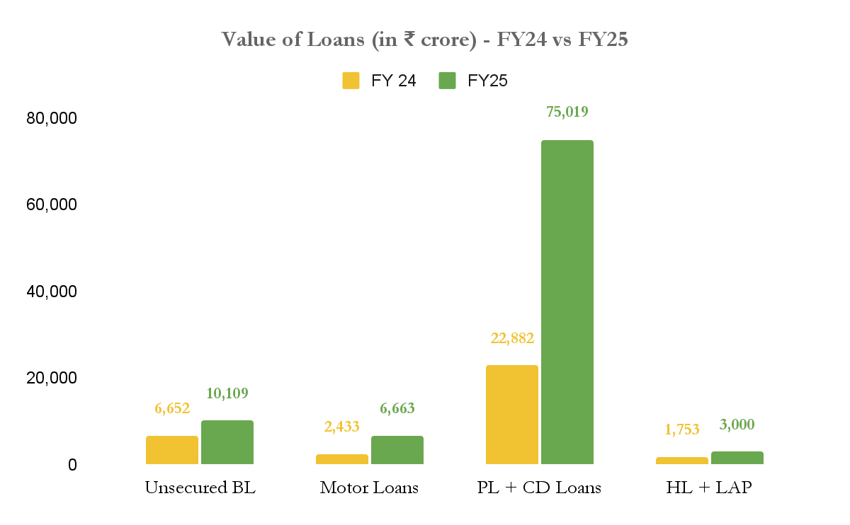
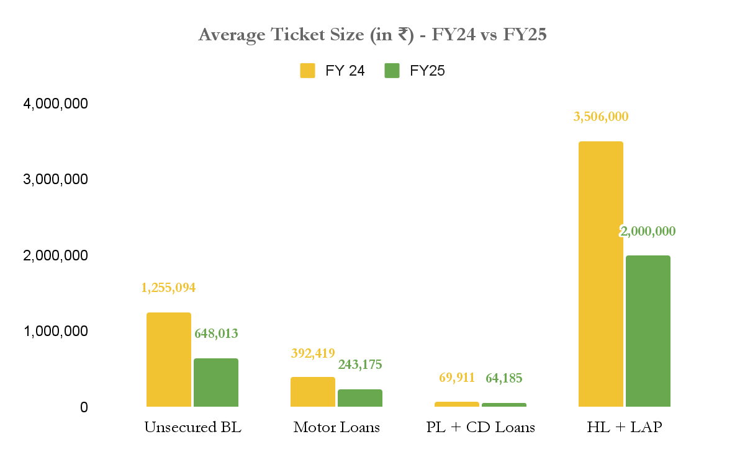
Usage is seen picking up in multiple loan products- beyond unsecured lending
Consumption loans (personal loans, consumer durable loans, and credit cards) have been the most buoyant loan segment.
Unsecured loan beyond personal consumption witnessing healthy traction, yet require additional data types. .
We are working on promoting usage of account aggregators in housing loans, MSME finance, cash flow based lending and government led financial inclusion schemes
NOTE: All the numbers in the graphs above are based on the actual, self-reported statistics by leading lending FIUs in the Account Aggregator (AA) ecosystem.

Slide 9
FY 25 witnessed more than 2.4 crore customers facilitated by AAs
Lending
PFM
Stockbroking
Life Insurance
₹1,07,917 crore
disbursed across
122 lakh
loans in FY25
76.9 lakh
PFM customers served in FY25
(only RIAs)
47.3 lakh
F&O accounts verified in FY25
28,472
Life insurance policies issued in FY25
According to self-reported data, the account aggregator ecosystem has facilitated 244+ lakh customers to avail a financial product or service using the account aggregator ecosystem in FY25.
* All the above numbers are based on self-reported data from a Sahamati survey of leading institutions in each category. The participating FIUs represent approximately 50% to 65% of successful consents within their respective segments.

Slide 10
Extrapolating self-reported data, we estimate 4.77 crore users in FY25
Use Cases | Self-reported Data | Number of FIUs | Consent Share (%) | Estimated Data | Additional estimates | Financial services delivered in FY25
Lending H1 (Volume and Value) | 55.07 lakh | 10 | ~63% | 88.04 lakh | – | 187.95 lakh loans disbursed – amounting to ₹1,66,049 crores
 | ₹46,746 crores | 10 | ~63% | ₹74,722 crores | –
Lending H2 (Volume and Value) | 66.92 lakh | 12 | ~67% | 99.92 lakh | –
 | ₹61,171 crores | 12 | ~67% | ₹91,327 crores | –
Stockbroking | 47.32 lakh | 3 | ~56% | 84.20 lakh | – | 84.20 lakh accounts verified
PFM | 76.9 lakh | 6 | ~47% | 163.75 lakh | 204.69 lakh* | 204.69 lakh PFM users
Insurance | 28,472 | 5 | ~87% | 32,875 | – | 0.33 lakh insurance policies
TOTAL |  |  |  |  |  | 477+ lakh customers served
* Based on industry interactions, we estimate that banks have served an additional 25% of PFM users over and above those reported by RIAs.

Slide 11
THANK YOU!
info@sahamati.org.in
OCTOBER 2025

